Slide 1
Cloud Computing
SEWP ZG527

Slide 2
Introduction to Cloud Computing, services and deployment models
Agenda
Introduction to Cloud Computing – Origins and Motivation
3-4-5 rule of Cloud Computing
Types of Clouds and Services
Cloud Infrastructure and Deployment

Slide 3
Motivation
Powerful multi-core processors
General purpose graphic processors
Superior software methodologies
Virtualization leveraging the powerful hardware
Wider bandwidth for communication
Proliferation of devices
Explosion of domain applications
Web Scale Problems
Web 2.0 and Social Networking
Information Explosion
Mobile Web
Notes:
RL 1.1

Slide 4
Evolution of Web
Explosive growth in applications:
biomedical informatics, space exploration, business analytics,
web 2.0 social networking: YouTube, Facebook
Extreme scale content generation: e-science and e-business data deluge
Extraordinary rate of digital content consumption: digital gluttony:
Apple iPhone, iPad, Amazon Kindle, Android, Windows Phone
Exponential growth in compute capabilities:
multi-core, storage, bandwidth, virtual machines (virtualization)
Very short cycle of obsolescence in technologies:
Windows 8, Ubuntu, Mac; Java versions; C → C#; Python
Newer architectures: web services, persistence models, distributed file systems/repositories (Google, Hadoop), multi-core, wireless and mobile
Diverse knowledge and skill levels of the workforce

Slide 5
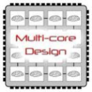
Technology Advances
Cloud applications: data-intensive, compute-intensive, storage-intensive
Bandwidth
WS
Services interface
Web-services, SOA, WS standards
VM0
VM1
VMn
Storage Models: S3, BigTable, BlobStore, ...
Virtualization: bare metal, hypervisor. …
Multi-core architectures
64-bit processor

Slide 6
What is Cloud Computing?
Cloud Computing is a general term used to describe a new class of network based computing that takes place over the Internet,
basically a step on from Utility Computing
a collection/group of integrated and networked hardware, software and Internet infrastructure (called a platform).
Using the Internet for communication and transport provides hardware, software and networking services to clients
These platforms hide the complexity and details of the underlying infrastructure from users and applications by providing very simple graphical interface or API (Applications Programming Interface).

Slide 7
What is Cloud Computing cont.…
In addition, the platform provides on demand services, that are always on, anywhere, anytime and any place.
Pay for use and as needed, elastic
scale up and down in capacity and functionalities
The hardware and software services are available to
general public, enterprises, corporations and businesses markets

Slide 8
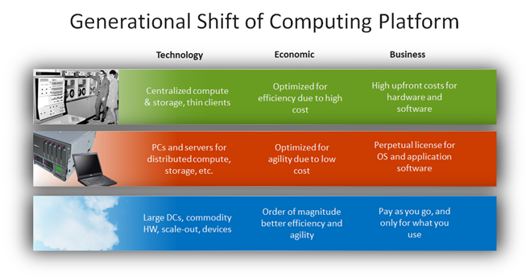
Drivers for the new Platform
http://blogs.technet.com/b/yungchou/archive/2011/03/03/chou-s-theories-of-cloud-computing-the-5-3-2-principle.aspx

Slide 9
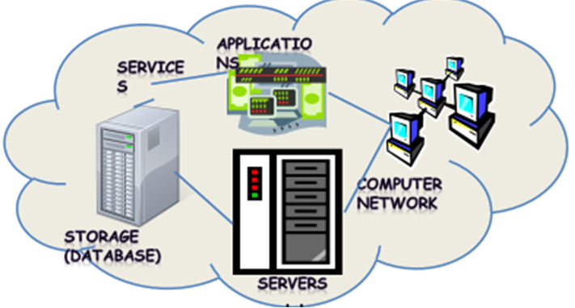
Cloud Summary
Shared pool of configurable computing resources
On-demand network access
Provisioned by the Service Provider

Slide 10
Cloud Summary…
Cloud computing is an umbrella term used to refer to Internet based development and services
A number of characteristics define cloud data, applications services and infrastructure:
Remotely hosted: Services or data are hosted on remote infrastructure.
Ubiquitous: Services or data are available from anywhere.
Commodity model: The result is a utility computing model similar to traditional that of traditional utilities, like gas and electricity - you pay for what you would want!

Slide 11
Cloud Computing
SEWP ZG527

Slide 12
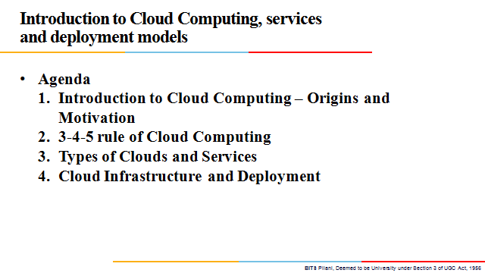

Slide 13
Cloud Computing: Definition
The US National Institute of Standards (NIST) defines cloud computing as follows:
Cloud computing is a model for enabling ubiquitous, convenient, on-demand network access to a shared pool of configurable computing resources (e.g., networks, servers, storage, applications, and services) that can be rapidly provisioned and released with minimal management effort or service provider interaction.
Notes:
RL 1.2

Slide 14
3-4-5 rule of Cloud Computing
NIST specifies 3-4-5 rule of Cloud Computing
3 cloud service models or service types for any cloud platform
4 deployment models
5 essential characteristics of cloud computing infrastructure

Slide 15
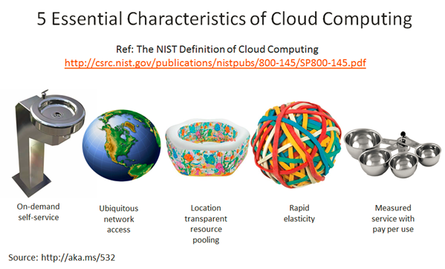
Characteristics of Cloud Computing
On demand self-service
Broad network access
Resource pooling
Rapid elasticity
Measured service

Slide 16
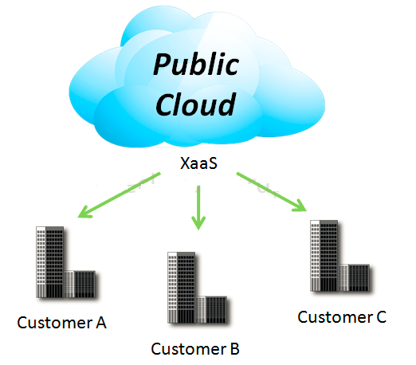
4 Deployment Models
1. Public Cloud
Mega-scale cloud infrastructure is made available to the general public or a large industry group and is owned by an organization selling cloud services.
Notes:
XaaS is Anything as a service
[http://www.definethecloud.net/cloud-types/]

Slide 17
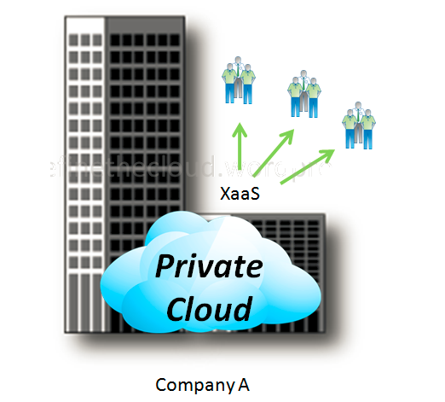
4 Deployment Models
2. Private Cloud
The cloud infrastructure is operated solely for an organization. It may be managed by the organization or a third party and may exist on premise or off premise.

Slide 18
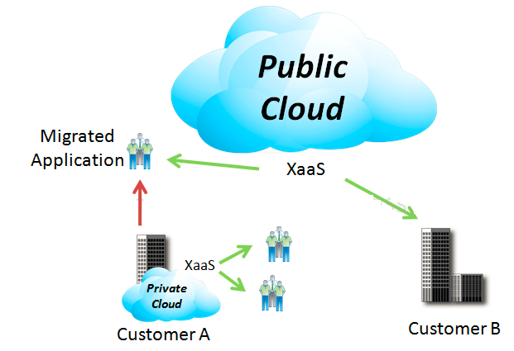
4 Deployment Models
3. Hybrid Cloud
The cloud infrastructure is a composition of two or more clouds (private or public) that remain unique entities but are bound together by standardized or proprietary technology that enables data and application portability

Slide 19
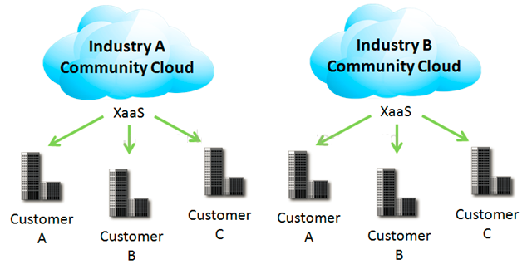
4 Deployment Models
4. Community Cloud
Community Clouds are when an ‘infrastructure is shared by several organizations and supports a specific community that has shared concerns (e.g., mission, security requirements, policy, and compliance considerations). It may be managed by the organizations or a third party and may exist on premise or off premise’ according to NIST.
A community cloud is a cloud service shared between multiple organizations with a common tie/goal/objective.
E.g. OpenCirrus

Slide 20
Cloud Computing
SEWP ZG527

Slide 21
Introduction to Cloud Computing, services and deployment models
Agenda
Introduction to Cloud Computing – Origins and Motivation
3-4-5 rule of Cloud Computing
Types of Clouds and Services
Cloud Infrastructure and Deployment

Slide 22
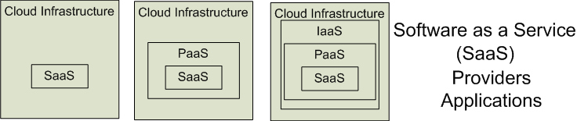

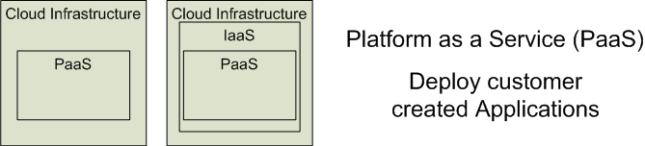

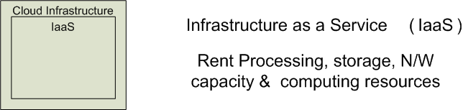


3 Cloud Service Models
Software as a Service (SaaS)
Platform as a Service (PaaS)
Infrastructure as a Service (IaaS)
SalesForce CRM
LotusLive
Google App Engine
Notes:
RL 1.3

Slide 23
Software as a Service (SaaS)
Software as a service features a complete application
offered as a service on demand.
A single instance of the software runs on the cloud
and services multiple end users or client organizations.
E.g. salesforce.com , Google Apps

Slide 24
Platform as a Service
Platform as a service encapsulates a layer of software and provides it as a service that can be used to build higher-level services.
2 Perspectives for PaaS :-
1. Producer:- Someone producing PaaS might produce a platform by integrating an OS, middleware, application software, and even a development environment that is then provided to a customer as a service.
2. Consumer:-Someone using PaaS would see an encapsulated service that is presented to them through an API. The customer interacts with the platform through the API, and the platform does what is necessary to manage and scale itself to provide a given level of service. Virtual appliances can be classified as instances of PaaS.

Slide 25
Infrastructure as a Service
Infrastructure as a service delivers basic storage and computing capabilities as standardized services over the network.
Servers, storage systems, switches, routers , and other systems are pooled and made available to handle workloads that range from application components to high-performance computing applications.

Slide 26
Service Models Summary
Cloud Software as a Service (SaaS)
The capability provided to the consumer is to use the provider’s applications running on a cloud infrastructure and accessible from various client devices through a thin client interface such as a Web browser (e.g., web-based email). The consumer does not manage or control the underlying cloud infrastructure, network, servers, operating systems, storage, or even individual application capabilities, with the possible exception of limited user-specific application configuration settings.
Cloud Platform as a Service (PaaS)
The capability provided to the consumer is to deploy onto the cloud infrastructure consumer-created applications using programming languages and tools supported by the provider (e.g., Java, Python, .Net). The consumer does not manage or control the underlying cloud infrastructure, network, servers, operating systems, or storage, but the consumer has control over the deployed applications and possibly application hosting environment configurations.
Cloud Infrastructure as a Service (IaaS)
The capability provided to the consumer is to rent processing, storage, networks, and other fundamental computing resources where the consumer is able to deploy and run arbitrary software, which can include operating systems and applications. The consumer does not manage or control the underlying cloud infrastructure but has control over operating systems, storage, deployed applications, and possibly select networking components (e.g., firewalls, load balancers).
.

Slide 27
Cloud Infrastructures
Key Technology is Virtualization
App
App
App
App
App
App
OS
OS
OS
Operating System
Hypervisor
Hardware
Hardware
Traditional Stack
Virtualized Stack
Virtualization plays an important role as an enabling technology for datacentre implementation by abstracting compute, network, and storage service platforms from the underlying physical hardware
Notes:
Virtualization is simulating a hardware platform, operating system, storage device or network resources

Slide 28
Cloud Providers Characteristics
Provide on-demand provisioning of computational resources
Use virtualization technologies to lease these resources
Provide public and simple remote interfaces to manage those resources
Use a pay-as-you-go cost model, typically charging by the hour
Operate data centers large enough to provide a seemingly unlimited amount of resources to their clients

Slide 29
Management of Virtualized Resources
Distributed Management of Virtual Machines
Reservation-Based Provisioning of Virtualized Resources
Provisioning to Meet SLA Commitments
Notes:
Distributed Management of Virtual Machines
Managing VMs need to set up custom software environments for VMs, setting up and managing networking for interrelated VMs, and reducing the various overheads involved in using VMs. Thus, VI managers must be able to efficiently orchestrate all these different tasks.
Reservation-Based Provisioning of Virtualized Resources
Determination of the demand for resources is known beforehand so that the computational resources must be available at exactly that time to process the data produced by the equipment
Provisioning to Meet SLA Commitments
IaaS clouds can be used to deploy services that will be consumed by users other than the one that deployed the services. cloud providers are typically not directly exposed to the service semantics or the SLAs that service owners may contract with their end users. The capacity requirements are, thus, less predictable and more elastic.

Slide 30
Cloud Infrastructure Anatomy
The key component of an IaaS cloud architecture is the cloud OS, which manages the physical and virtual infrastructures and controls the provisioning of virtual resources according to the needs of the user services
A cloud OS’s role is to efficiently manage datacenter resources to deliver a flexible, secure, and isolated multitenant execution environment for user services that abstracts the underlying physical infrastructure and offers different interfaces and APIs for interacting with the cloud
While local users and administrators can interact with the cloud using local interfaces and administrative tools that offer rich functionality for managing, controlling, and monitoring the virtual and physical infrastructure, remote cloud users employ public cloud interfaces that usually provide more limited functionality

Slide 31
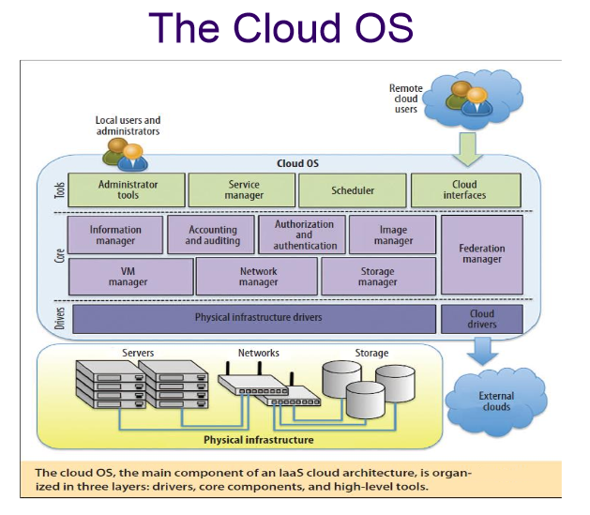
The cloud operating system is responsible for:
1. managing the physical and virtual infrastructure,
2. orchestrating and commanding service provisioning and deployment
3. providing federation capabilities for accessing and deploying virtual resources in remote cloud infrastructures

